Slide 1
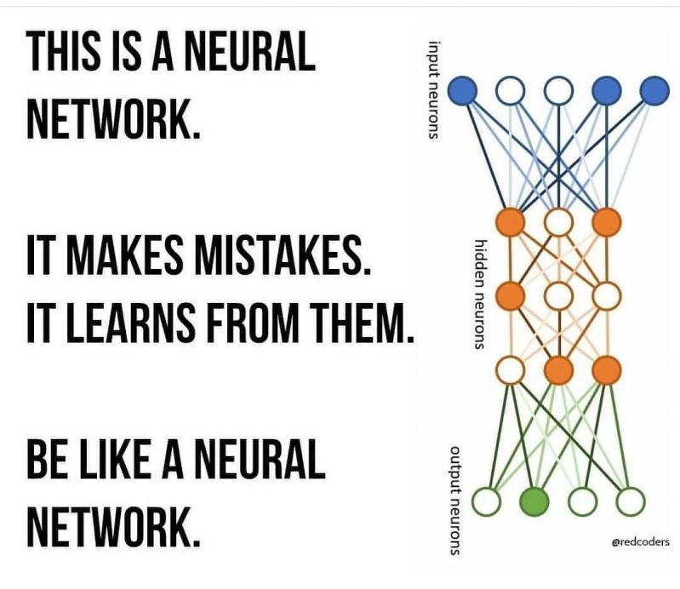

Slide 2
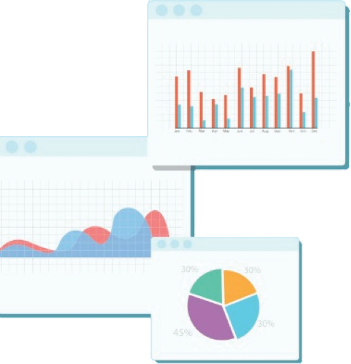


Welcome to Week 11
Lecture 1!
Data Science in Python &
Machine Learning

Slide 3
Announcements
Assignments Due this Week by Friday at 9am PST
Belt Exam
April 8th - April 10th
Must have attended 80% of classes
Must have submitted all assignments from weeks 1 & 2
Resubmits from week 1 are due by Friday at 9am PST (April 8th)

Slide 4
Learning Goals
After this lesson you will be able to:
Define a neural network
Explain how the parts of a neural network fit together, including:
Input layers
Hidden layers
Output layers
Activation functions
Loss functions
Code a simple feed-forward neural network in Keras using densely connected layers.

Slide 5
Neural Networks

Slide 6
Input
Think back to linear regression:
Each feature is multiplied by a coefficient (weight) and they are added together along with the intercept.
Each feature has an independent contribution
Feature 1
Output
Feature 2
X1 * W1
+ X2 * W2
+ X3 * W3
+ X4 * W4
+ X5 * W5
+ Intercept
Feature 3
Prediction
=
Feature 4
linear model Y = Σ(xi*wi) + bias
Feature 5

Slide 7
A neural network has (at least one) additional layer(s) that take into account interactions between features.
Input Layer
Hidden Layer
Feature 1
Node 1
Output Layer
Feature 2
Node 2
Prediction
Feature 3
Node 3
Feature 4
Node 4
Feature 5

Slide 8
This shows how Node 1 takes information from each feature to produce an output
Input Layer
Hidden Layer
Feature 1
Node 1
Output Layer
Feature 2
Node 2
Prediction
Feature 3
Node 3
Feature 4
Node 4
Feature 5

Slide 9
This happens with each of the nodes in the hidden layer
The more nodes we have, the more interactions we capture
Input Layer
Hidden Layer
Feature 1
Node 1
Output Layer
Feature 2
Node 2
Prediction
Feature 3
Node 3
Feature 4
Node 4
Feature 5

Slide 10
Note that this process results in a prediction for ONE data point!
Input Layer
Hidden Layer
Feature 1
Node 1
Output Layer
Feature 2
Node 2
Prediction
Feature 3
Node 3
Feature 4
Node 4
Feature 5

Slide 11
Let’s fill in some features data for one data point.
12
3
Node 1
Prediction
6
8
2

Slide 12
- For each node, a weight is applied to each feature.
Weights can be positive or negative
- Weights are randomly initialized then adjusted as learning proceeds
12
Weight: ?
3
Weight: ?
Weight: ?
Node 1
Prediction
6
Weight: ?
8
Weight: ?
2

Slide 13
For example, let’s apply the weights shown
The greater the weight, the greater the influence of that feature on Node 1
12
Weight: 2
3
Weight: 4
Weight: -1
Node 1
Prediction
6
Weight: -3
8
Weight: 5
2

Slide 14
For example, let’s apply the weights shown
The greater the weight, the greater the influence of that feature on Node 1
12
12 x 2 = 24
3 x 4 = 12
6 x -1 = -6
8 X -3 = -24
2 X 5= 10
Weight: 2
16
3
Weight: 4
Weight: -1
Node 1
Prediction
6
Weight: -3
8
Weight: 5
2

Slide 15
A similar process happens for EACH node
Each node has different weights. Note that this shows Node 2
12 x 3 =36
3 x -1 = -3
6 x 5 = 30
8 X -4 = -32
2 X 2 = 4
12
Weight: 3
35
3
Weight: -1
Weight: 5
Node 2
Prediction
6
Weight: -4
8
Weight: 2
2

Slide 16
The process repeats for each node
Input Layer
Hidden Layer
12
16
Output Layer
3
35
Prediction
6
12
8
8
2

Slide 17
Activation Function
Activation function applies a function to each node and defines the output of that node
Computational unit connects the weighted inputs through activation function
Activation functions are a way of introducing non-linearity to the neural network to allow them to capture more complex relationships
The activation function can also limit the range of final outputs to match the problem type.
More info in this article

Slide 18
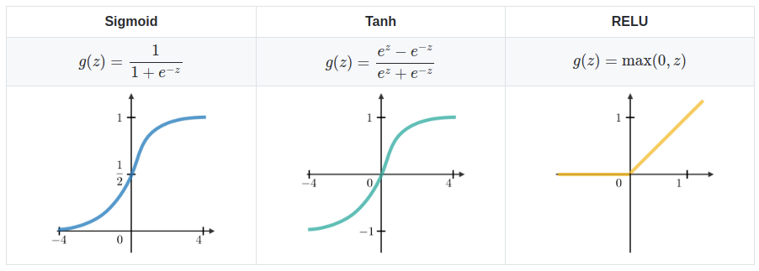
Activation Function
ReLU (Rectified Linear Activation) is very common for hidden layers
If the sum is positive, output is the input number
But, if the sum is negative, a value of 0 is applied instead
Hyperbolic tangent used in classification
Sigmoid is used for models where we have to predict probability as an output

Slide 19
Activation function
Input Layer
Hidden Layer
12
16
weight: ?
Output Layer
3
weight: ?
35
Prediction
6
12
weight: ?
8
8
weight: ?
2

Slide 20
Let’s demonstrate the effect of node weights
Input Layer
Hidden Layer
12
16
weight: 3
Output Layer
3
weight: -1
35
Prediction
6
12
weight: 1
8
8
weight: 2
2

Slide 21
Multiply each node by its weight and sum
16 x 3 = 48
35 X -1 = -35
12 X 1 = 12
8 X 2 = 16
Input Layer
41
Hidden Layer
12
16
weight: 3
Output Layer
3
weight: -1
35
Prediction
6
12
weight: 1
8
8
weight: 2
2

Slide 22
That is the prediction that is made
16 x 3 = 48
35 X -1 = -35
12 X 1 = 12
8X 2 = 16
Input Layer
41
Hidden Layer
12
16
weight: 3
Output Layer
3
weight: -1
35
Prediction: based on type of problem and activation function
6
12
weight: 1
8
8
weight: 2
2

Slide 23
Forward Propagation
The process we just went through is called ‘forward propagation’ because it moves information forward from input → hidden layers → output
The model does this for each sample and produces an array of predictions
The model then compares the predictions to the true values in the target (y_train) array and determines the error for each sample.
It uses one of many loss functions to combine those errors into a Cost or what sets of weights lead to what array of errors.
The model now has a function that maps the full set of weights and inputs to a particular Cost, or combined error across all samples.

Slide 24
Backward Propagation
Backward propagation is the process changing the weights of the nodes to reduce the Cost or the combination of errors for each sample.
Changing the weights IS the process of learning.

Slide 25
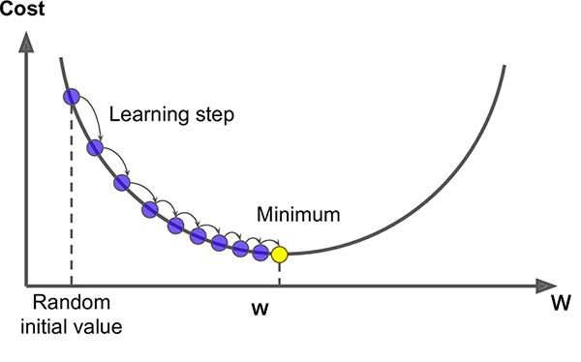
How does the model know how to adjust the weights?
Gradient Descent
Sum of
errors
Analogy Time!
Imagine you are trying to walk to the lowest point in the area
You tentatively put your foot out and see what it feels like (differential equations!)
If it is higher, you don’t go that way
If it is lower, you take the step
Then you continue this process
Value of one specific weight

Slide 26
Summary:
One Epoch is when:
Forward Propagation
The model makes predictions on ALL data points, or observations.
The model calculates the Cost Function by combining those errors using a Loss Function
Back Propagation
The model uses Gradient Descent to determine how each weight in each layer needs to change in order to minimize the Cost Function

Slide 27
Neural Networks
A model can and often do have MANY hidden layers!
(Today’s Neural Networks can even have up to 1000s of layers!!)
Every layer discovers increasingly complex patterns
Neural Networks are often used for complex tasks such as interpreting images, reading texts, and much more.

Slide 28
Code-a-long
Next, we will go together to build a neural network in Keras.
Here is the notebook

Slide 29
Practice Mock belt exam
We can discuss the solution in office hours Thursday.

